Slide 1
Capstone Project
Indian Restaurant in Paris

Slide 2
Table of Content
Business Problem
Data Gathering
Methodology
Results
Conclusion

Slide 3
Business Problem
Find locations to setup an Indian Restaurant in Paris with the following requirements:
Close to the iconic Louvre Museum
Less Crowded With Restaurants
No Indian Restaurants in the vicinity

Slide 4
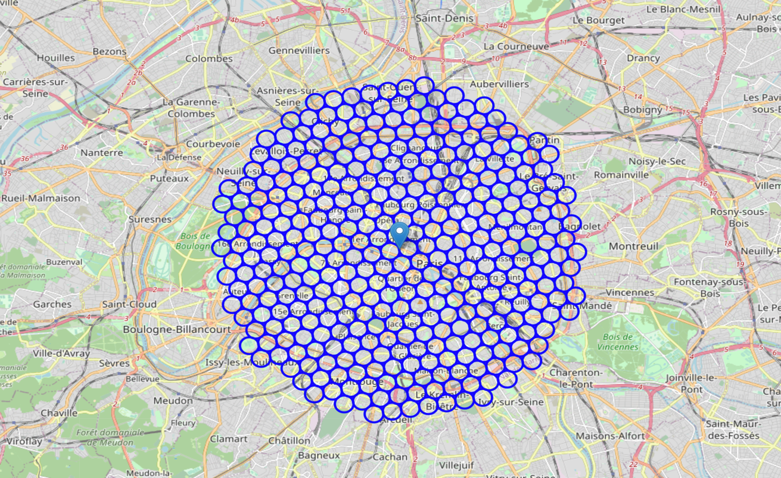
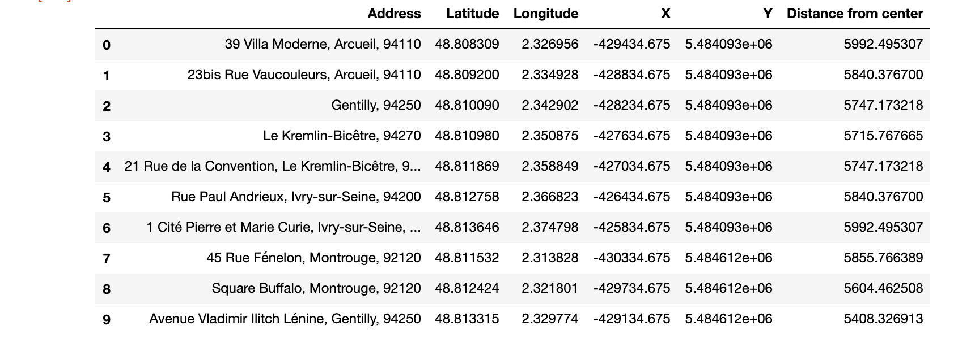
Data
Divided the whole city into 364 regularly spaced neighborhoods
Gathered the addresses of their centers using TOM API

Slide 5
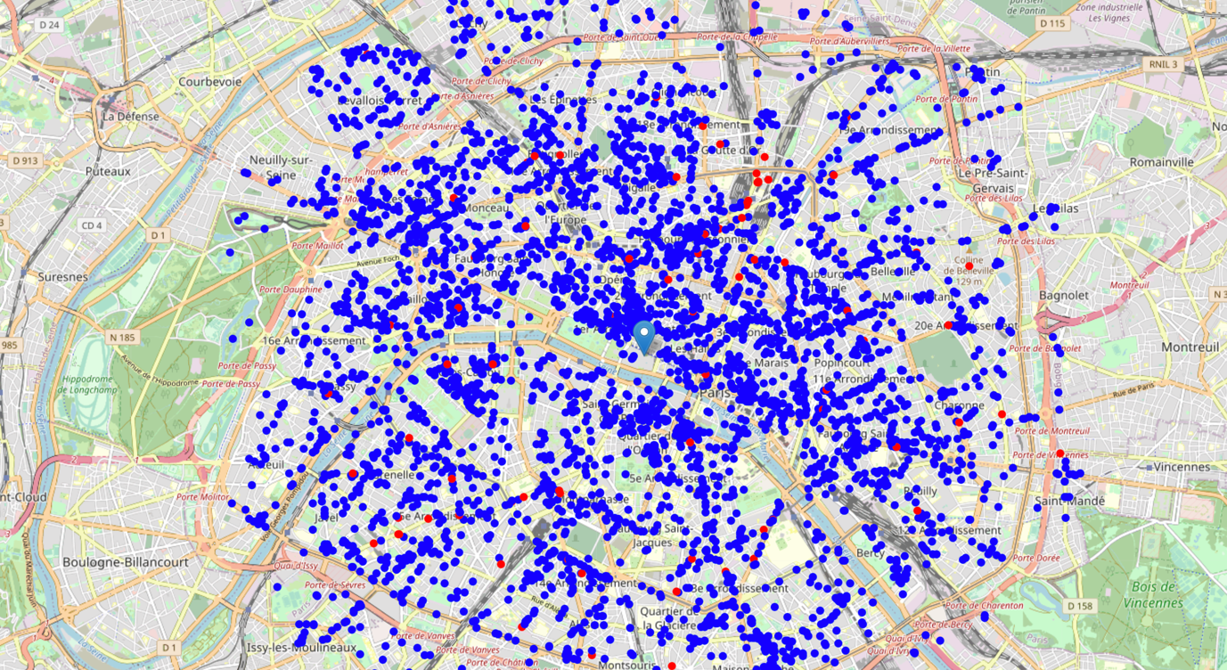
Data
A map showing all the restaurants in Paris. The red ones are the Indian Restaurants

Slide 6
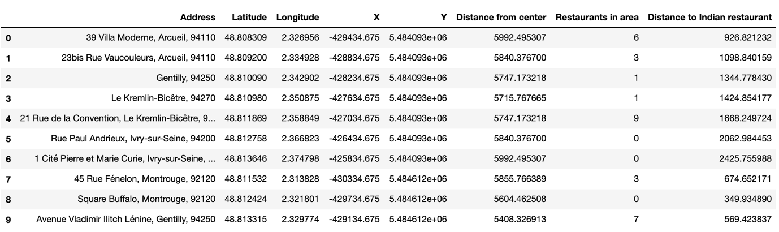
Methodology
Calculated the number of restaurants in each neighborhood.
Calculated the distance of all Indian Restaurants from the neighborhood’s centers

Slide 7
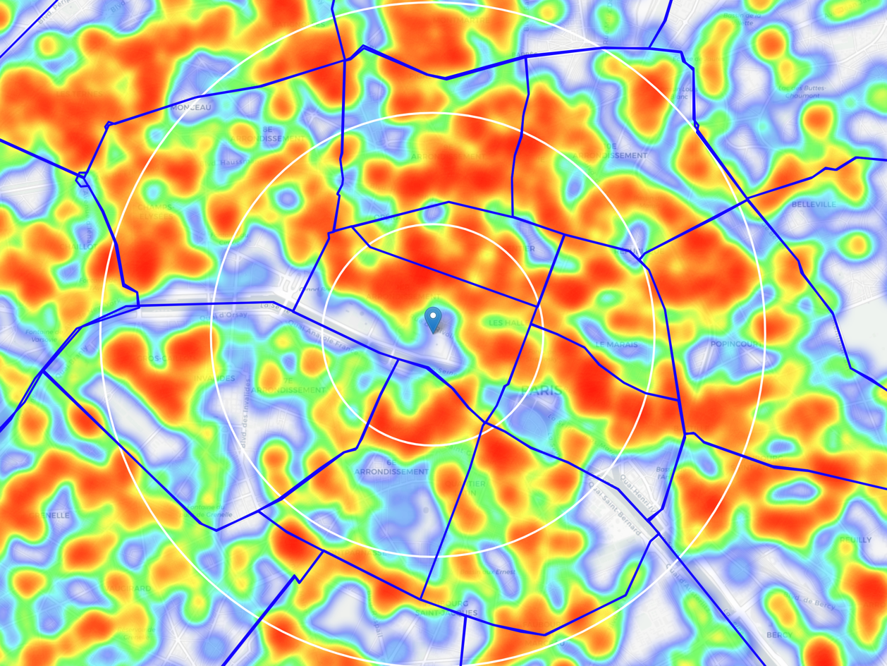
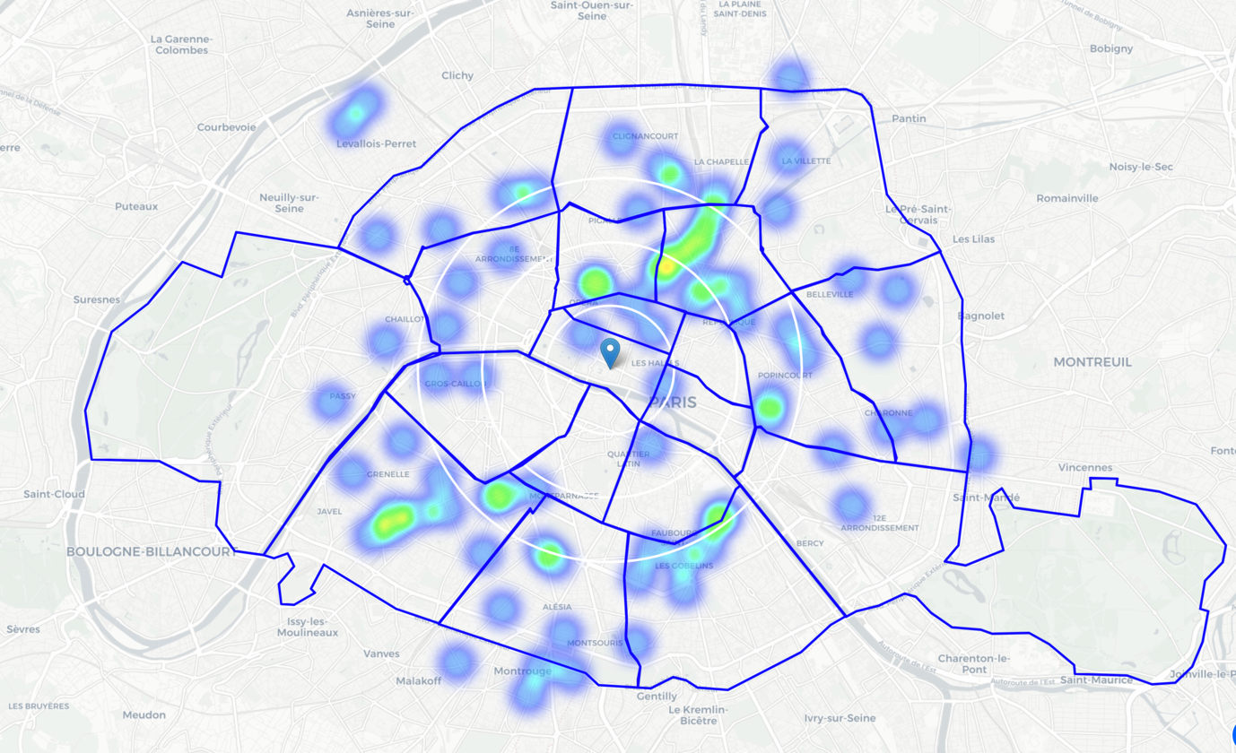
Methodology
Heatmap of all the restaurants
Heatmap of only Indian Restaurants

Slide 8
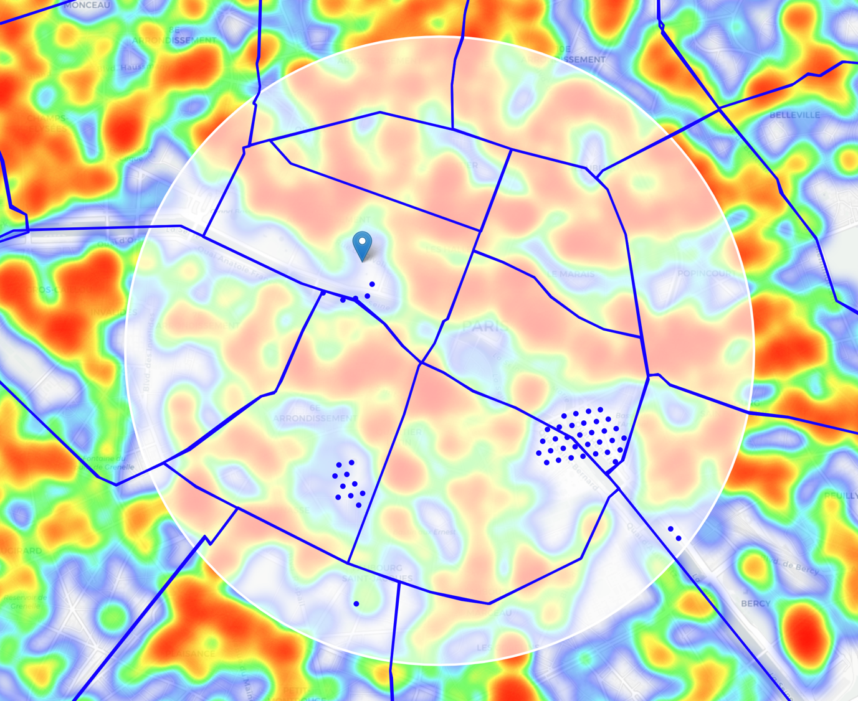
Methodology
The favorable locations in the area of Interest

Slide 9
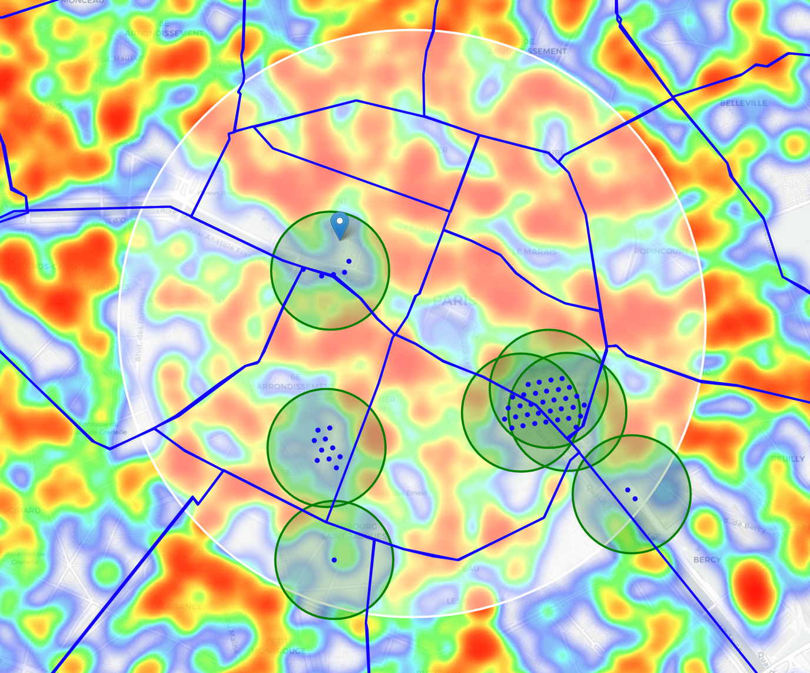
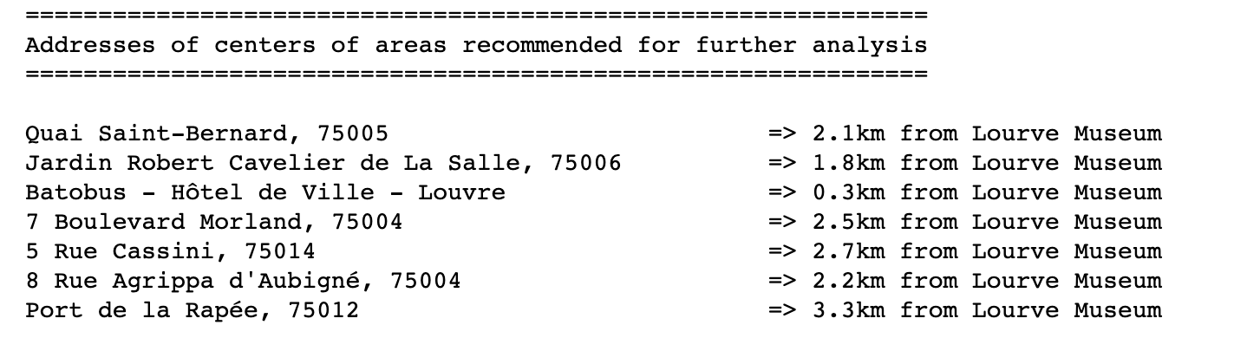
Results

Slide 10
Conclusion
We conclude from the analysis that we found many such locations in the Panthéon Borough and some close locations in the Louvre Borough itself.
The most favourable being ‘Batobus, Hotel de Ville – Louvre’ which is within 300 metres of the Louvre Museum.

Slide 11
Thank you!

